Slide 1
Sustainability of hardwood poplar biofuel plantations
Dr. Amy Klocko
Oregon State University

Slide 2




Four research groups
Mark Coleman
Soil and water emissions
Brian Moser
Wildlife
Steve Strauss
Genetic containment
Todd Rosenstiel
Air quality

Slide 3
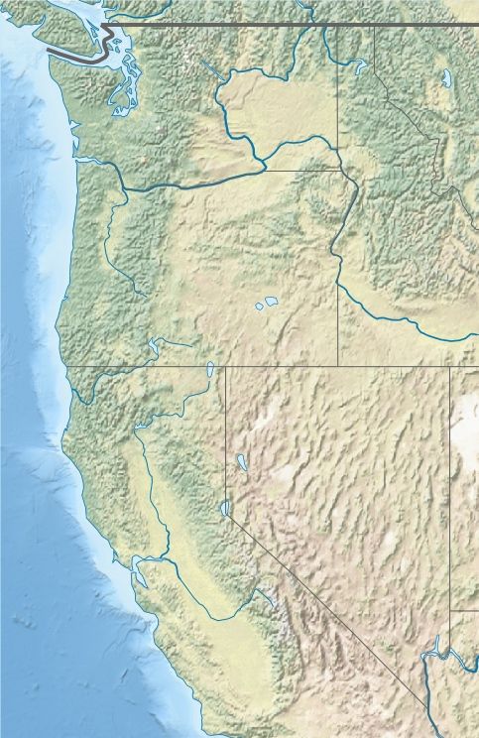


Four demonstration sites are providing a wealth of information
Pilchuck WA
Hayden ID
Jefferson OR
Clarksburg CA

Slide 4
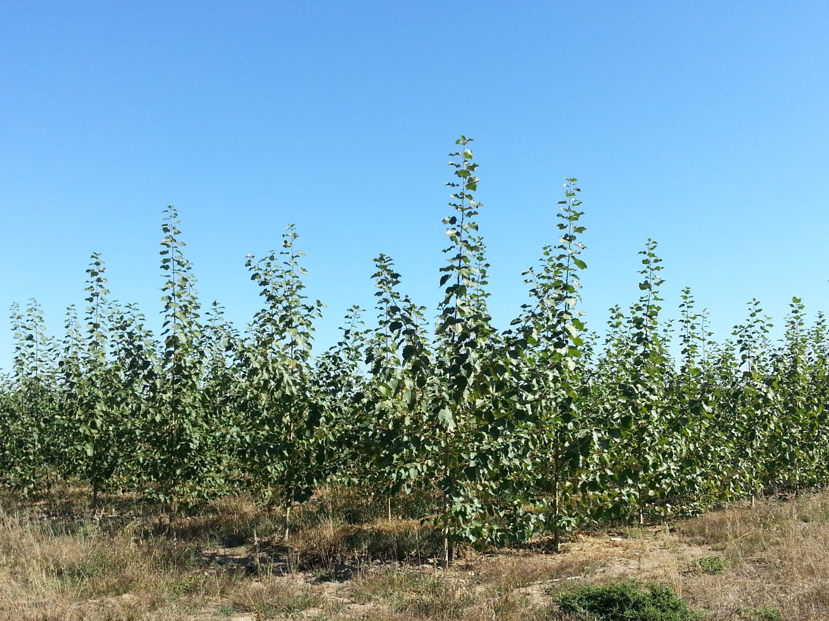
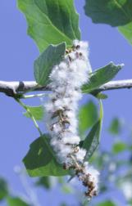
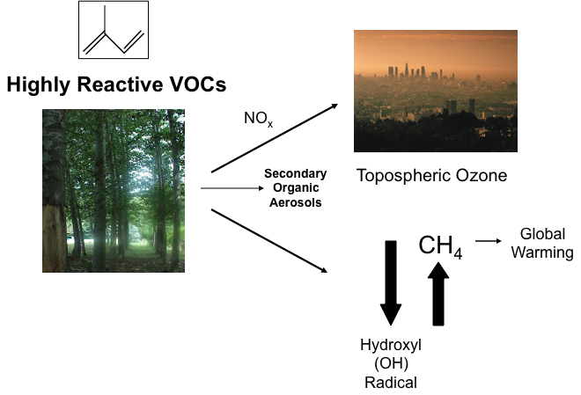
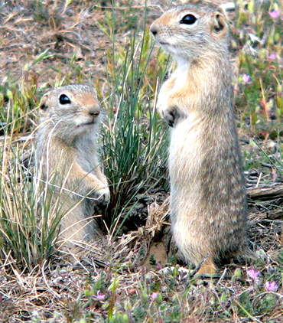
Pollen and seeds
Volatile organic compounds
Wildlife
Water runoff
Soil greenhouse gas emissions
Nutrient leaching
Notes:
Jefferson 9-29-2015

Slide 5
Soil and water
Mark Coleman
University of Idaho

Slide 6
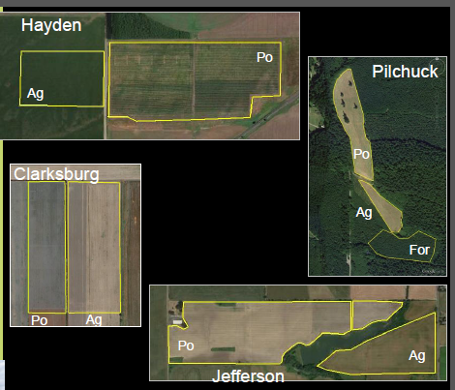
Approach used: comparison of agricultural fields and poplar stands
Clarksburg | Hayden | Jefferson | Pilchuck
poplar | poplar | poplar | poplar
hay | hay, wheat | wheat | hay
--- | --- | --- | forest

Slide 7
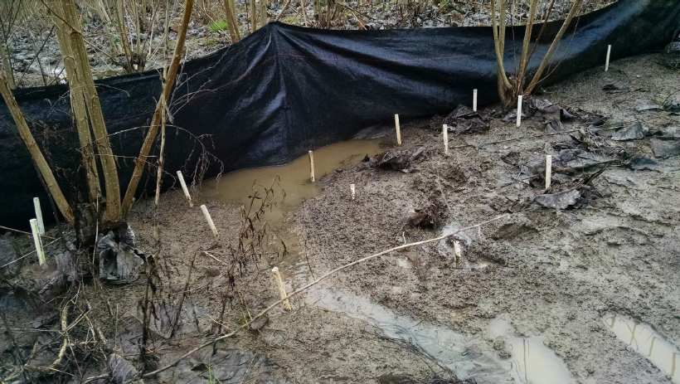
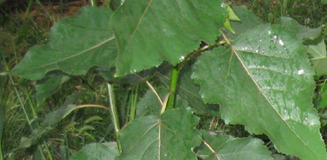
Parameters measured to quantify environmental impact
Off-site transport
  Nutrient leaching
  Erosion and runoff
  Greenhouse gas flux
Soil quality indicators
  Soil organic matter
  Physical structure
  Chemical balance
  Biological activity

Slide 8
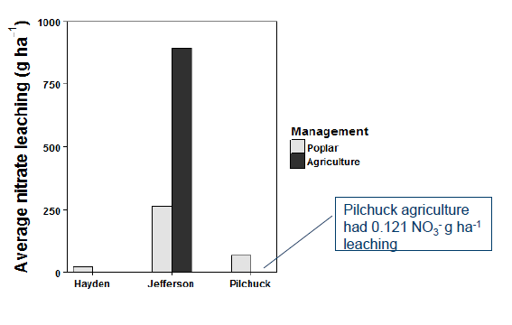
Nutrient leaching levels depend on soil richness
Nutrient rich sites have higher nutrient leaching from agriculture than poplar
Nutrient limited sites have lower leaching from agriculture

Slide 9
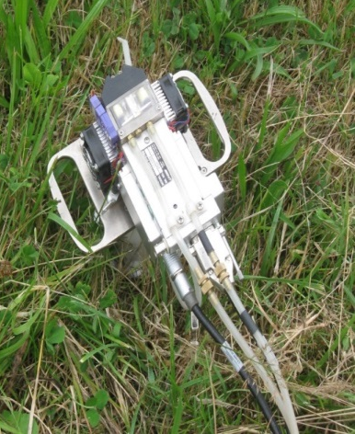
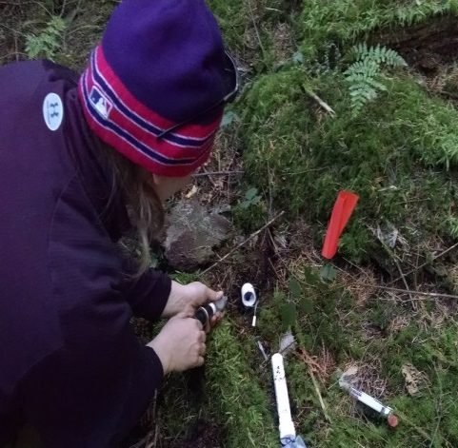
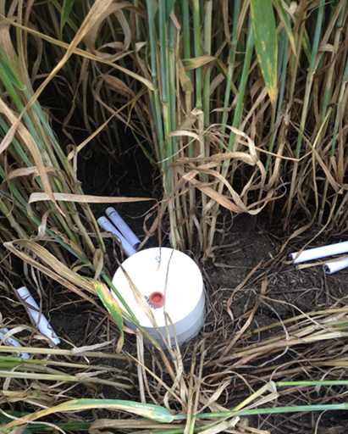
Annual greenhouse gas flux rates vary by gas, location, and crop
Data from 2014-2015
CO2
N2O
CH4

Slide 10
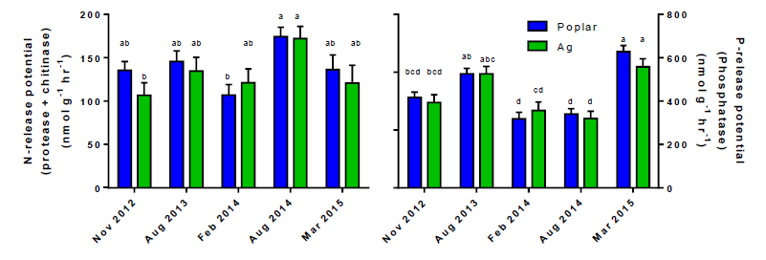
Poplar bioenergy plantations have no measureable affect on nutrient release

Slide 11
Main findings
Poplar soil and water quality is not degraded relative to agricultural management
High nutrient leaching from nutrient rich sites is improved by poplar, but leaching increases from nutrient limited sites
Greenhouse gas flux varies by gas, location, and crop
Soil and water quality data collected from AHB can be used to estimate impacts during scale-up of poplar biomass industry

Slide 12
Future needs
Continued data collection at existing sites
Collect data from larger-scale plantations

Slide 13
Wildlife
Brian Moser
Rocky Mountain Wildlife Institute

Slide 14
Rationale
The establishment of 400,000ac of plantations has the potential to affect biodiversity at the stand and landscape level
What happens to wildlife populations and biodiversity when we replace pre-existing land uses with hybrid poplar plantations?

Slide 15

Approach used: sampled biodiversity at all four bioenergy plantations
Hayden Jefferson Clarksburg Pilchuck
Season 1
Season 2
Post-Coppice
Year 1
Post-Coppice
Year 2
Spring
2016
Spring
2016

Slide 16
Small mammal abundance and richness is higher in poplar plantations than reference sites
poplar
reference

Slide 17
Song bird abundance and richness is higher in poplar plantations than reference sites
poplar
reference

Slide 18
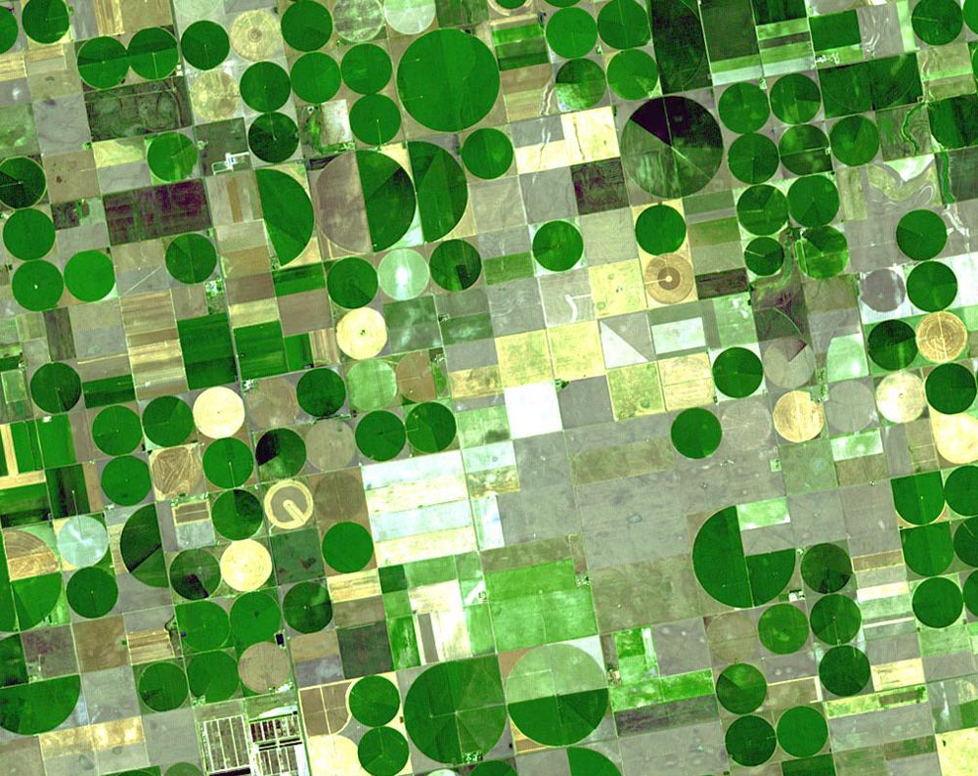
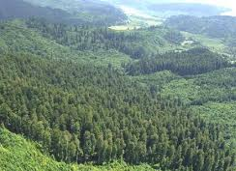
Landscape considerations: location of the plantation matters
Contributes to Biodiversity
Detracts from Biodiversity

Slide 19
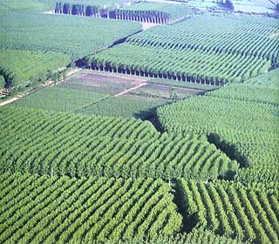
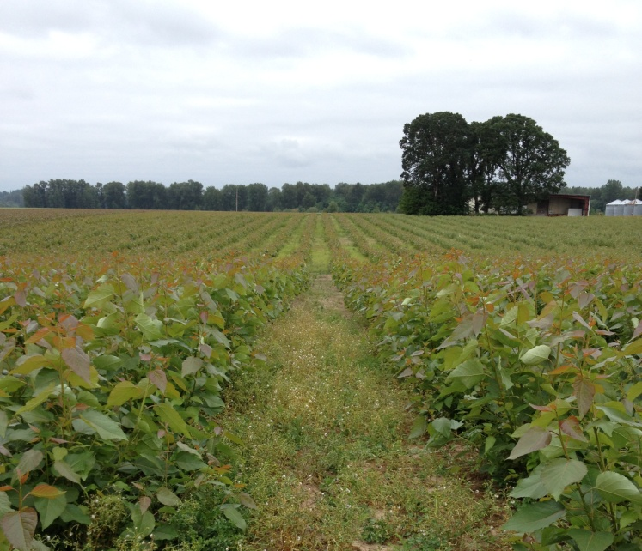

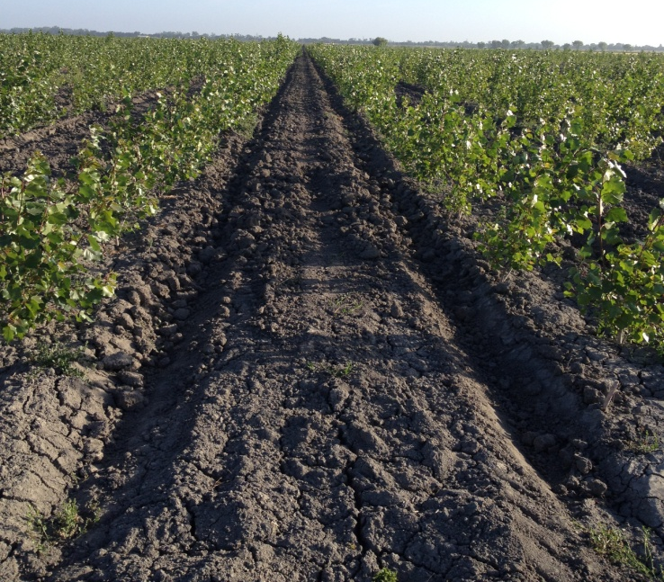
Within stand considerations: how plantations are managed matters
Contributes to Biodiversity
Detracts from Biodiversity

Slide 20
Main findings
Where plantations are established determines the effects on biodiversity
How plantations are managed determines the effects on biodiversity

Slide 21
Management recommendations
Establish plantations in agricultural areas rather than forest or shrub lands
Provide/maintain heterogeneity within plantations
Be aware of any rare, threatened and endangered species that might be negatively impacted by plantation establishment

Slide 22
Air quality
Todd Rosenstiel
Portland State University

Slide 23
Rationale
Plant VOCs impact atmospheric chemistry, what are the impacts of poplar bioenergy plantations?
Todd Rosenstiel
10x Anthropogenic
www.sciencefriday.com/guests/todd-rosenstiel

Slide 24
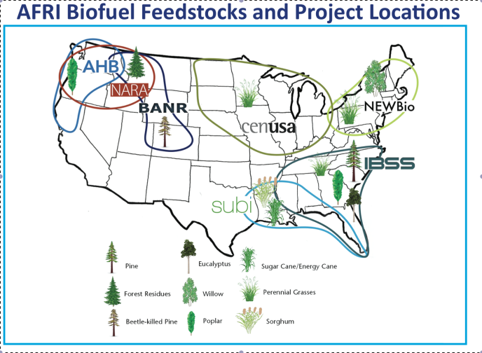
Approaches used
Modeling Framework for connecting bVOCS to regional air quality
Develop a low-cost methodology for clonal screening of emissions
Refine/Deploy “simple” system for quantifying canopy emissions in situ

Slide 25
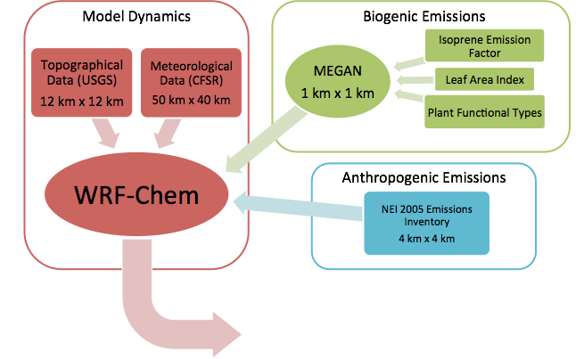
A transferable modeling framework : evaluating air quality implications of planting locations
Bioenergy
Crop
Specific
Details
Site/Region
Specific
Details (N0_{X}/VOC)
Assessing Replacement Scenarios -
Implications of Scale, Feedstock Performance,
and Cropping Locations

Slide 26
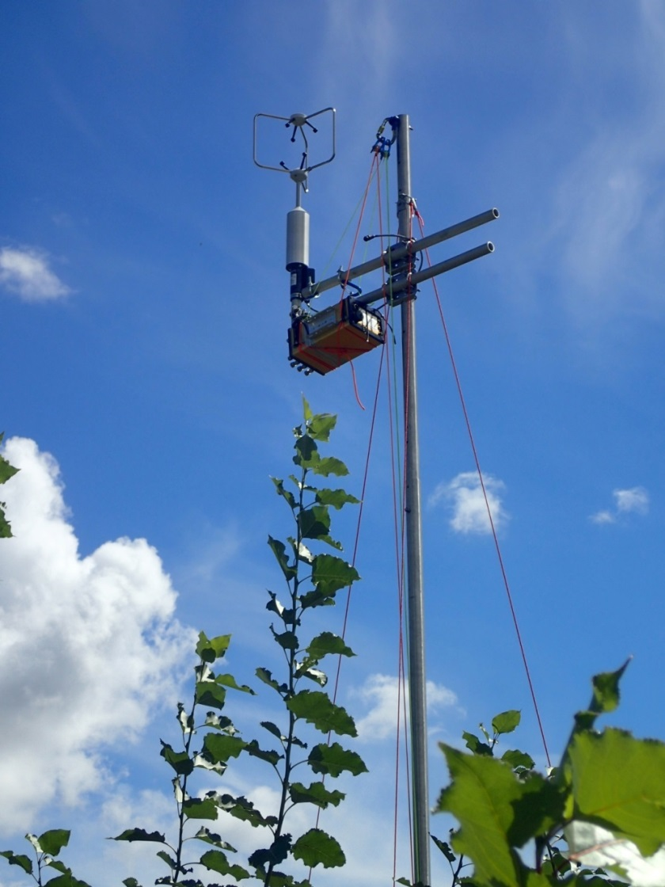
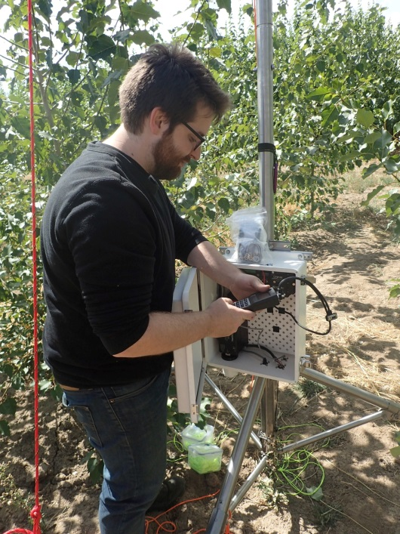

Developed a low-cost methodology for clonal screening of Poplar leaf bVOC emissions
Jefferson, OR AFRI Plantation
Portable
Relatively low-cost
Off-line analysis

Slide 27
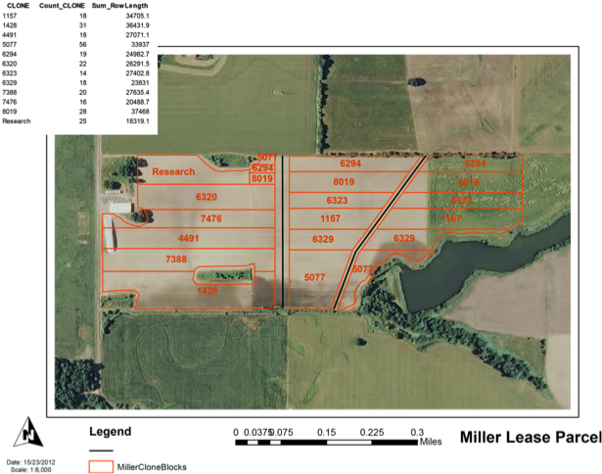
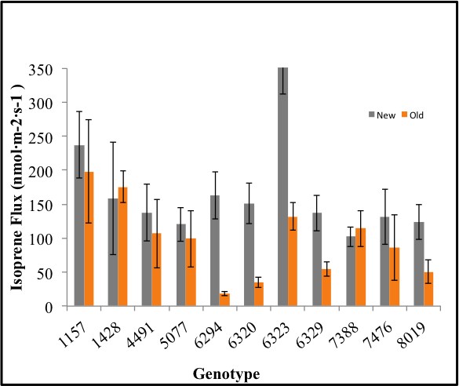
Hybrid poplar clones vary in isoprene emission
Jefferson, OR AFRI Plantation
USDA-AFRI Advanced Hardwoods Jefferson, OR
Clones were screened using the new portable system and an older method

Slide 28
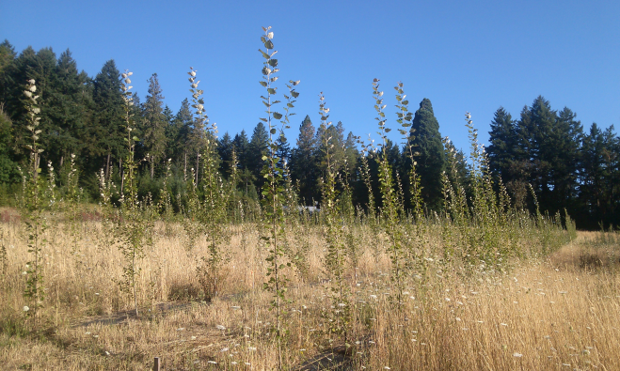
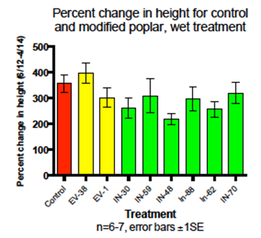
Breeding and/or genetic engineering can be used to reduce isoprene levels
Isoprene Emission (nmol/m2/sec)

Slide 29
Main findings
Location matters for impacts on air quality
Portable system for measuring volatile organic compounds works well in the field
Hybrid poplar clones vary in bVOC emission levels

Slide 30
Genetic containment
Steve Strauss
Oregon State University

Slide 31

Rationale
Genetic engineering (GE) a valuable tool for economics and sustainability
    Feedstock quality modification, coproducts (enzymes, bioplastics), input reduction, yield, containment of exotic species
Social, marketplace, and regulatory limits on use of GE
are severe (e.g., FSC system)
  Gene flow to certified and wild stands
  a major issue
Male and female sterility needed in poplar
  Targeting transcription factors that regulate male and female meristem / organ development

Slide 32
Approach used
Examine whether impairment of LFY and/or AG genes causes sterility in the greenhouse
  Early-flowering achieved by FLOWERING LOCUS T
  RNAi, dominant negative
Assess if impaired LFY / AG genes impart sterility in the field
Determine efficiencies of site-directed mutation of LFY and AG genes
  ZFN, TALEN, CRISPR systems

Slide 33
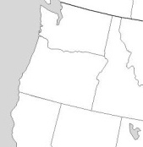
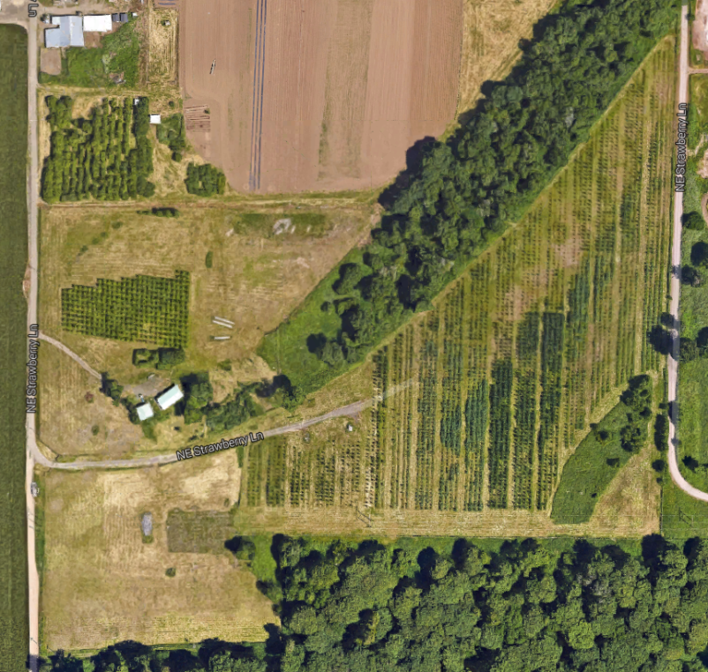
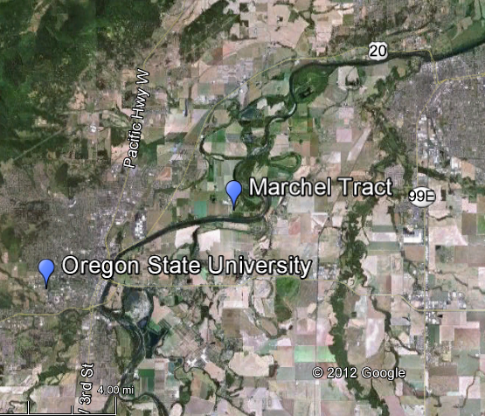
USDA APHIS-authorized poplar sterility field trial planted summer 2011 (9 acres)
c
c
Marchel Tract
Sweetgum Sterility trial; planted 2007
Poplar Sterility Trial

Slide 34
3rd generation sterility field trial summary
3,414 trees planted in 9 acres
3 clones x 2 blocks each (2 female, one male)
23 constructs, 1-35 events, 1-6 ramets
Targeting LFY, AG and other floral pathway genes
96% survival since planting in 2011
717
353
6K10
717
6K10
353

Slide 35
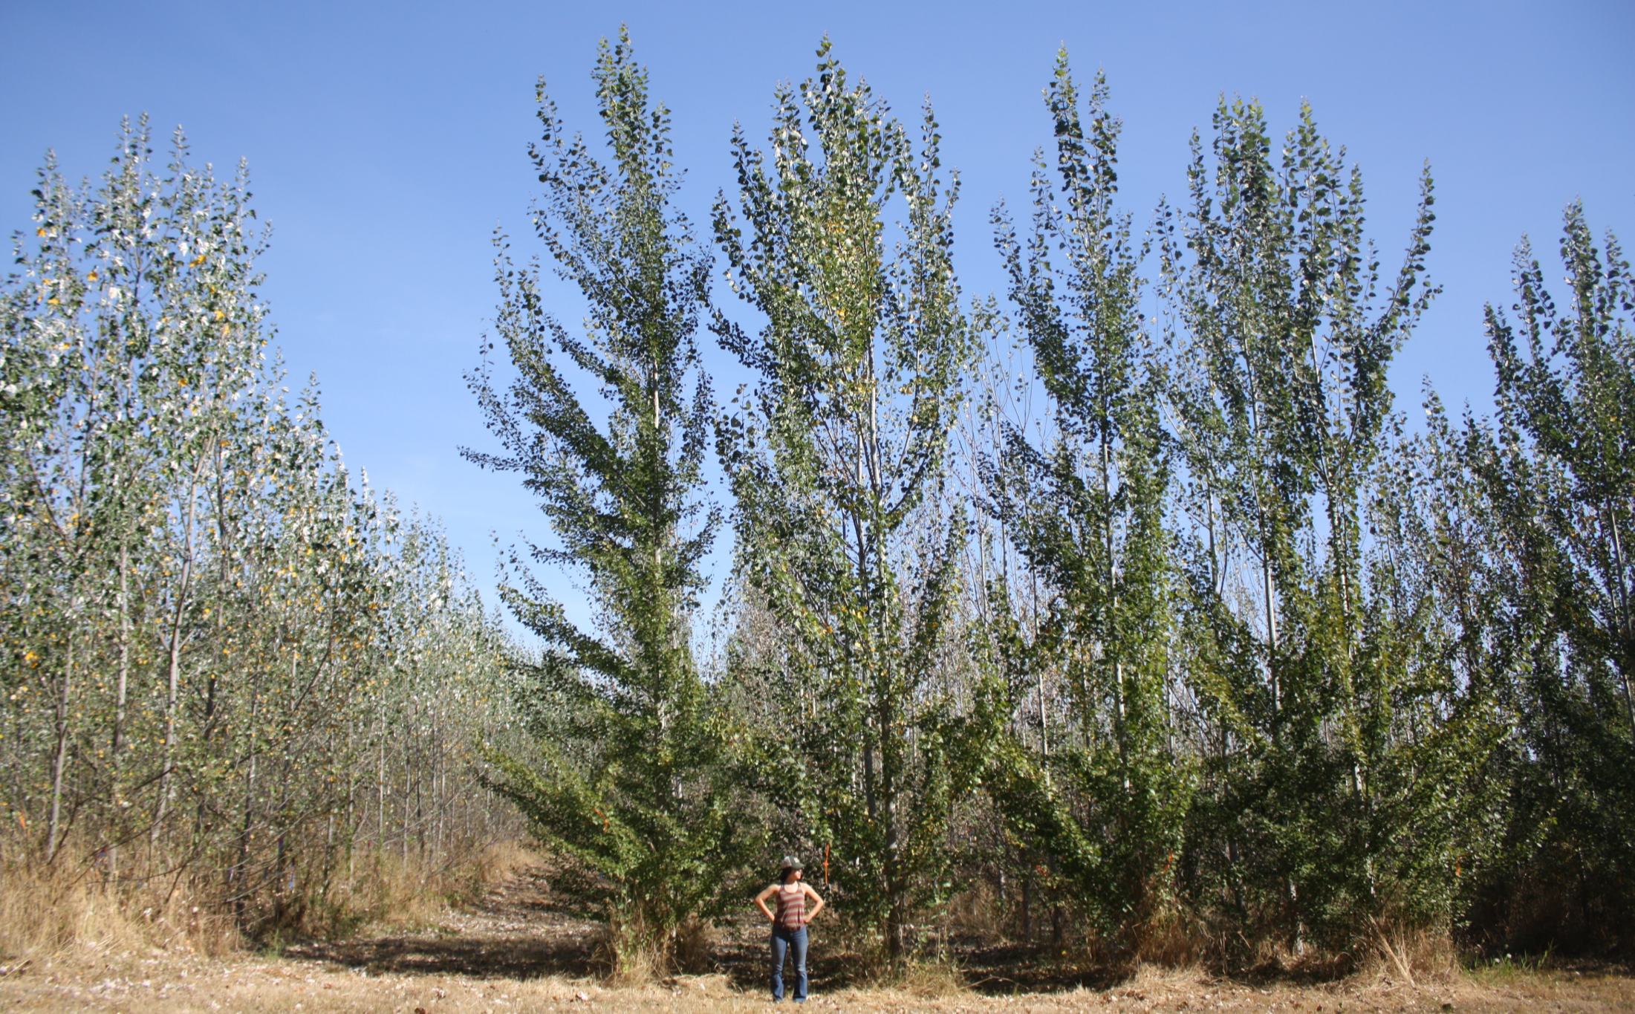
The research trees look like a forest – analyzing flowers in 2017 is going to be a challenge!
5 FT 2 inches
August 2016

Slide 36
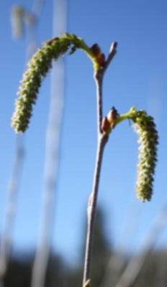
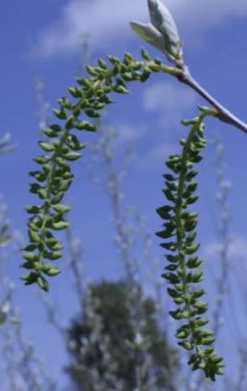
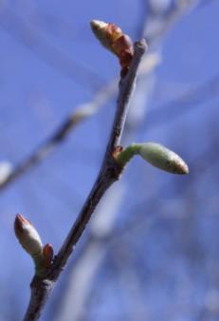
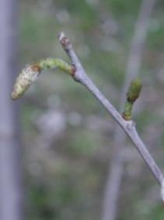
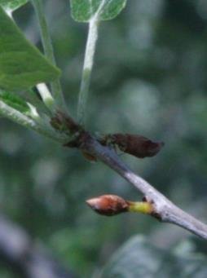
RNAi:LFY trees appear to be female sterile
WILD TYPE
March
April
May
RNAi-LFY
Klocko et al. Nature Biotechnology 2016

Slide 37
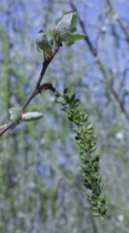
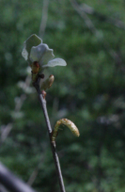
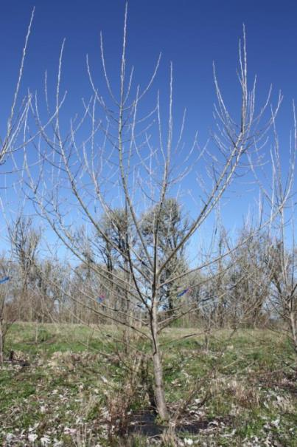
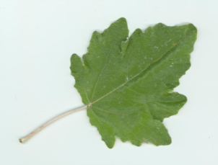
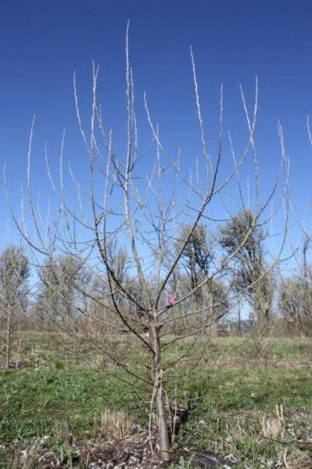
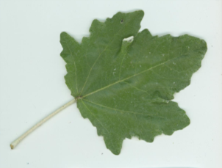
Female sterile RNAi-LFY trees have normal vegetative performance
control
RNAi-LFY
control
RNAi-LFY
control
RNAi-LFY
Klocko et al. Nature Biotechnology 2016

Slide 38
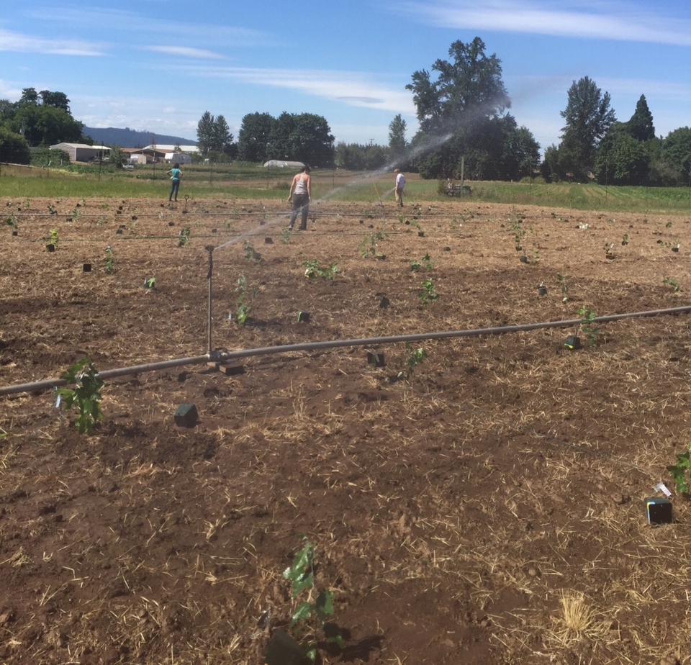
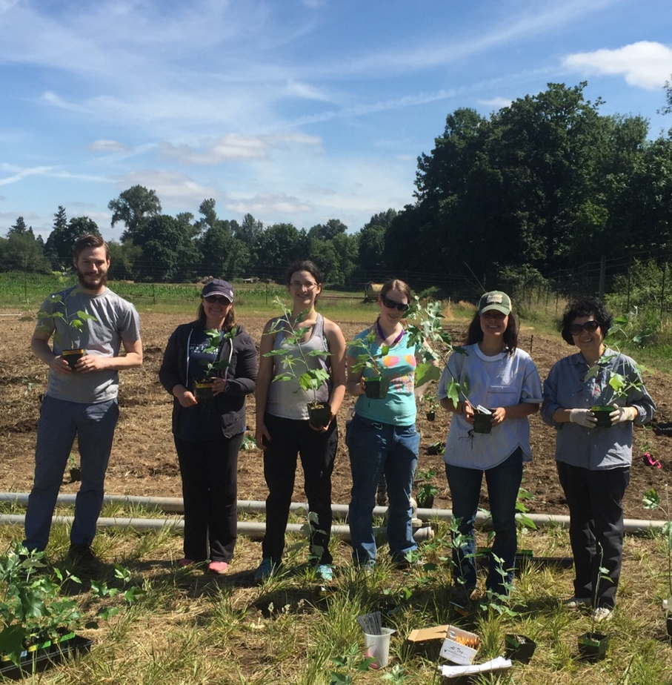
New field trial is underway to test the vegetative performance of a larger set of RNAi:LFY female trees
Planted July 5, 2016
Klocko et al. PloS ONE 2016

Slide 39
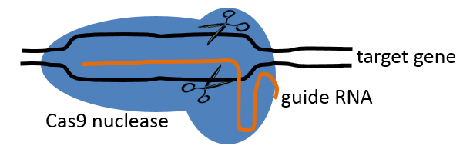
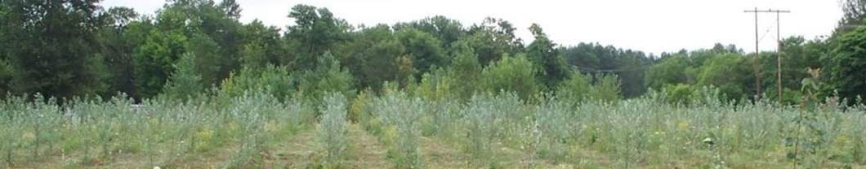
While our trees were growing, so was the field of custom genome editing
CRISPR-Cas9
Discovered in 2002
Over 1,100 studies (80% published after 2013)
Permanent changes to genes of interest
Inexpensive and easy to create the vector
High rate of gene targeting in plants (up to 91%)
Known to work very well in poplar

Slide 40
High homozygous mutation rates in poplar LFY gene
Construct | GE events sequenced | Mutant events | Type of mutation | # of events (%)
LFYsg1 (exon 1) | 131 | 109 (83%) | Homozygous | 16 (12%)
 |  |  | Heterozygous | 93 (71%)
 |  |  | None | 22 (17%)
LFYsg2 (promoter) | 46 | 43 (93%) | Homozygous | 10 (22%)
 |  |  | Heterozygous | 33 (71%)
 |  |  | None | 3 (7%)
LFYsg1-LFYsg2 | 75 | 70 (93%) | Homozygous | 4 (5%)
 |  |  | Heterozygous | 66 (88%)
 |  |  | None | 5 (7%)
Cas (empty vector) | 14 | 0 (0%) | None | 14 (100%)
Total (w/out control) | 252 | 222 (88%) | Homozygous | 30 (12%)
 |  |  | Heterozygous | 192 (76%)
 |  |  | None | 30 (12%)
Similar findings for the poplar AG genes as well

Slide 41
Key findings
CRISPRs are very efficient
  Normal transformation rates
  High rate of biallelic mutations (12-58%)
RNAi can be used to achieve female-sterile poplar
  Stable across growing seasons
  Initial planting shows normal growth
Elite and male poplar clones could be transformed with RNAi or CRISPR constructs

Slide 42
Future prospects

Slide 43
Key findings overall
Plantations are an invaluable resource
Poplar soil and water quality is not degraded relative to agricultural management
Plantations can support biodiversity
Emission of volatile organic compounds can be measured in the field and vary by clone
Genetic engineering and breeding can be used to obtain reduced-emission poplar
RNAi can be used to achieve female sterility under field conditions

Slide 44
Research needs
Use plot scale information at the four locations to model environmental services throughout the PNW.
Understand how poplar’s capacity for nutrient uptake will help energy farms to provide environmental services
Longer time scale of date collection at existing locations
  Soil and nutrient quality across harvest cycles
  Wildlife monitoring over additional seasons
Collection of data from all locations
  Volatile organic compound quantification at additional plantations
Testing of genetic modification and reduced isoprene systems in elite poplar clones
Identification of species which may be impacted by non-flowering and reduced emission trees

Slide 45
Implementation of key findings
Integrate findings
  Selection of best lines of hybrid poplar based on growth, emissions, and conversion
  Select plantation locations and sizes based on potential site impacts as well as infrastructure
  Manage and harvest sites for optimizing yield and minimizing ecological impacts
Create management guidelines for landowners
Work with regulators
  Provide biodiversity information
  Genetic modification currently prohibits plantation certification

Slide 46




Acknowledgements

