Slide 1


Genetically engineered trees
Impressive progress, opportunities, and obstacles
Steve Strauss
Distinguished Professor
Oregon State University
Steve.Strauss@OregonState.Edu

Slide 2
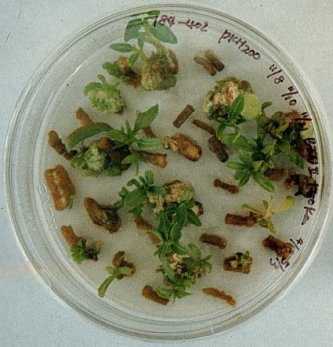
What is genetic engineering (GE)
Direct modification of DNA
  Vs. indirect modification in breeding and genomic selection
Asexually modified in somatic cells
  Then regenerated into whole organisms, usually starting in Petri dishes

Slide 3
Plan
Types of tree/forest systems
General benefits from GE methods
Constraints to use
Examples of progress

Slide 4
Types of forests

Slide 5
Four major types of tree-dominated communities
Food: Orchards
  High genetic control – often one or very few varieties (=clones) – Intensive agronomy
Wood, pulp, energy: Short rotation, fast growing
  Often limited number of varieties (dozens), also agronomic management, 5-10 year cycle
Wood, pulp: Planted but long rotation times
  Very high genetic diversity, many decadal cycle, little management, ecological services
Wild trees
  Many genotypes, many species, many ecological services and social values, poor access & ecnomics

Slide 6

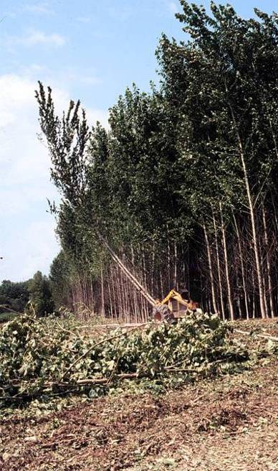
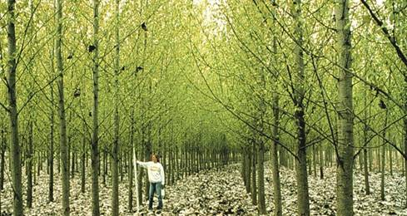
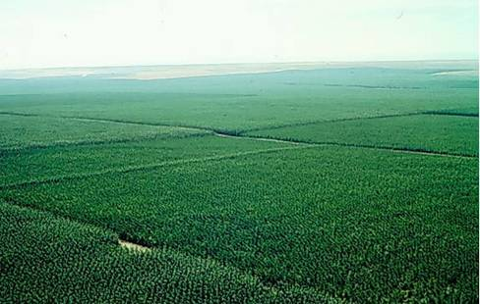
Poplar plantations an example of ag-like forestry

Slide 7
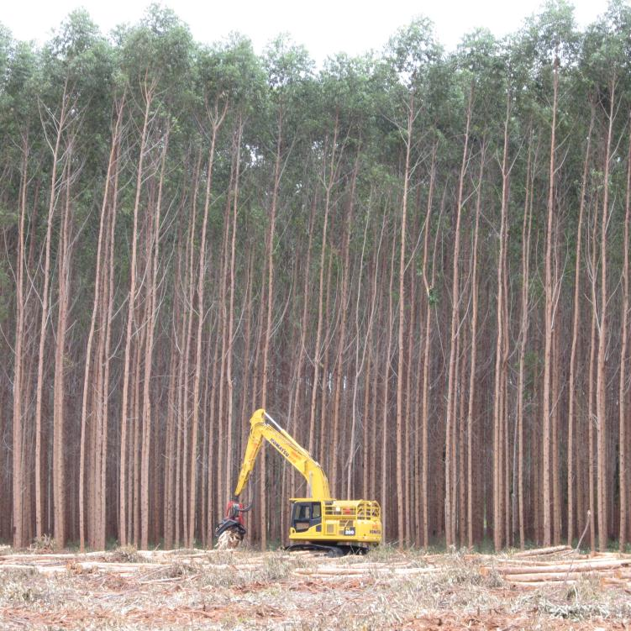
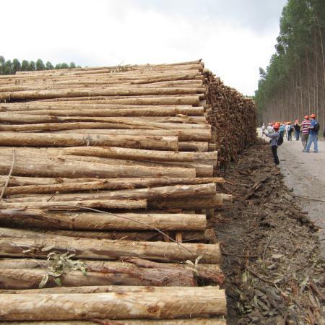
Eucalypts in Brazil another example of ag-like forestry

Slide 8
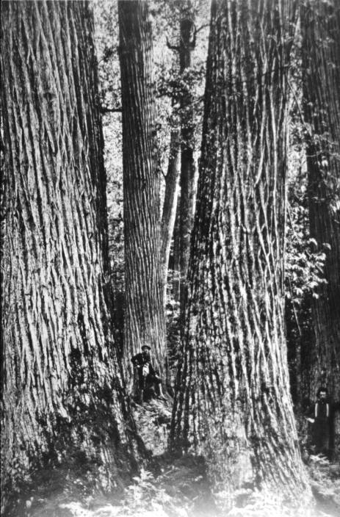
Wild forest tree protection or restoration the other extreme –
American
Chestnut restoration

Slide 9
Benefits

Slide 10
GE methods of special value for trees due to breeding constraints
Difficulty to inbreed
Long breeding cycle
Important ag crop breeding tools unavailable
  Hard to introgress desired genes from other species or genotypes
  Hard to fix rare, desired (e.g., loss of function) mutations
  Hard to identify and use dominant, major genes
Asexually propagated varieties of high value
  Capacity to “edit” intact genotypes without sexual recombination a powerful tool

Slide 11
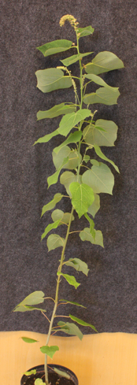
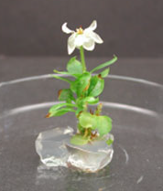
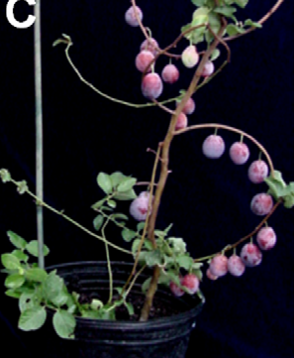
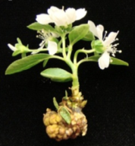
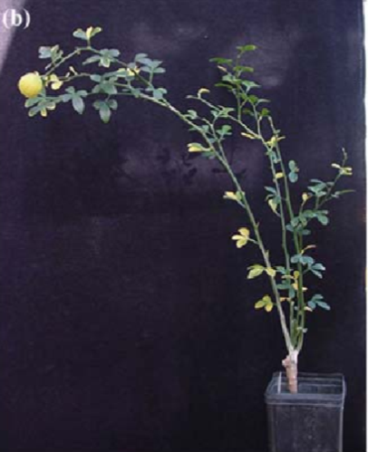
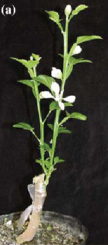
Overexpression of endogenous flowering genes induce early flowering in several tree species
Poplar
Apple
Plum
Orange

Slide 12

RNA interference (RNAi) for gene suppression

Slide 13
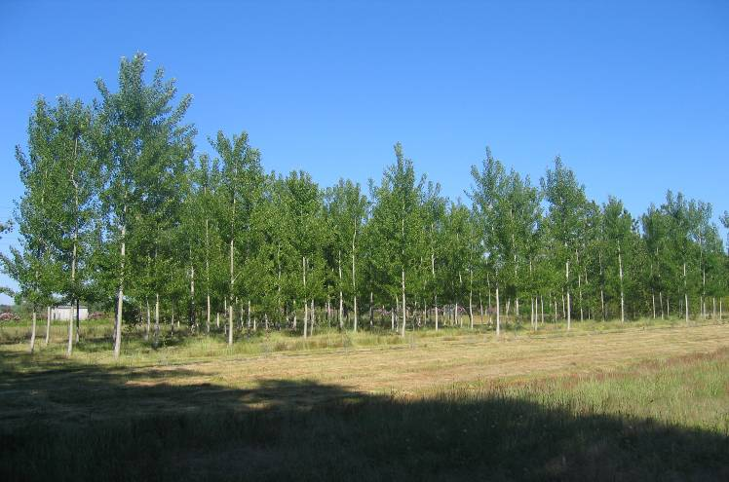
Dominant gene action / RNAi
Lignin-modification of elite poplar variety in France by RNAi
G. Pilate, INRA, France

Slide 14
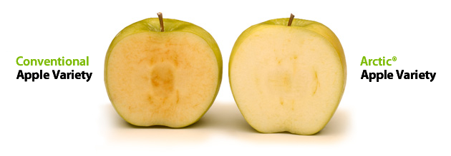
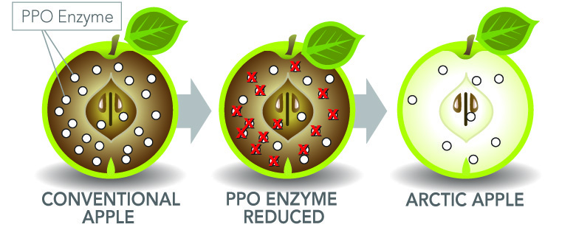
Non-browning “Arctic Apple”
RNAi suppression of native polyphenol oxidase gene expression
Courtesy of Jennifer Armen, Okanagan Specialty Fruits, Canada

Slide 15

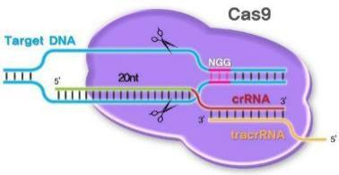
Coming: Gene editing technology for diverse traits
Precise control over gene insertion location
Ability to modify native genes efficiently

Slide 16
Constraints

Slide 17
Constraints - 1
Trees often rich in diversity due to early state of domestication
  GE often not needed
  Molecular markers, genomic selection generally a more potent and rapid molecular approach
Genetic transformation methods often very difficult and highly genotype-specific
  Very limited advances outside of a few intensively studied species – often mostly proprietary
Wood properties (lumber, pulp, energy) often not precisely controlled
  Most plantations are not clonal: Thus variable
  Increased precision of GE not important

Slide 18
Constraints - 2
Tree genes controlling traits poorly known, and often polygenic
  One or few gene traits rare in most tree species
  Association genomic studies rectifying this to some degree
Long rotations, low value: Economics of intensive genetics, asexual propagation, often marginal
  GE science, technology, patents, regulations, market restrictions add considerably more cost and risk
Regulatory and market barriers extreme
  Presumption of harm from method, each insertion
  Extensive gene flow during research and application
  “Green certification” exclusions of all GE trees

Slide 19
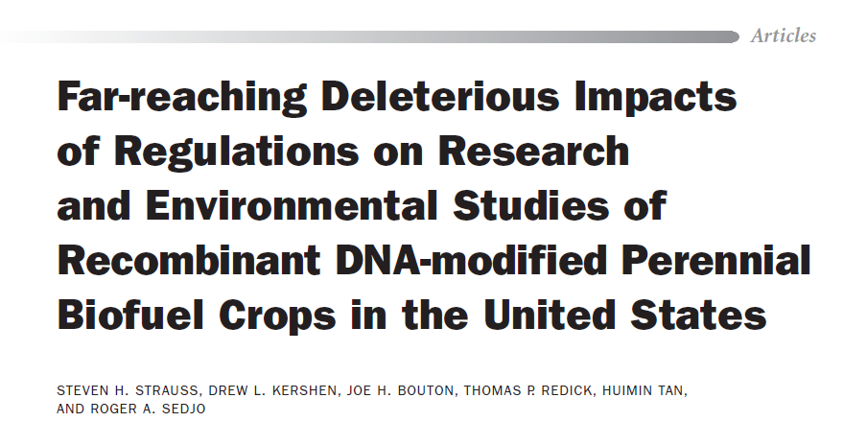
Detailed criticisms of regulations and the harm done to research and application
October 2010 / Vol. 60 No. 9 • BioScience 729

Slide 20
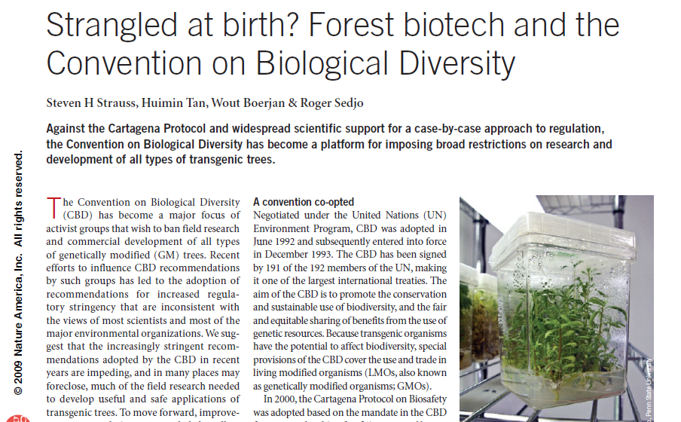

An international regulatory issue given Cartagena Protocol and trade

Slide 21
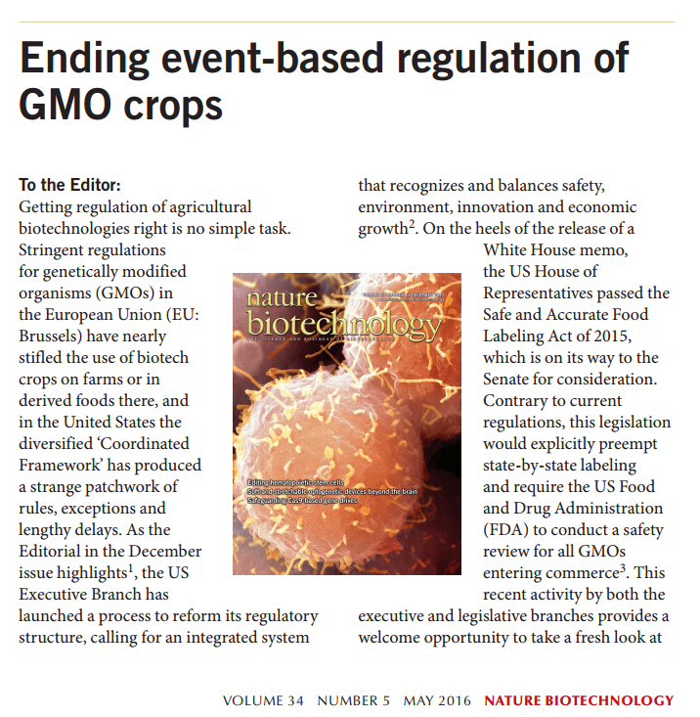
One of the big problems is cost of regulating every insertion

Slide 22
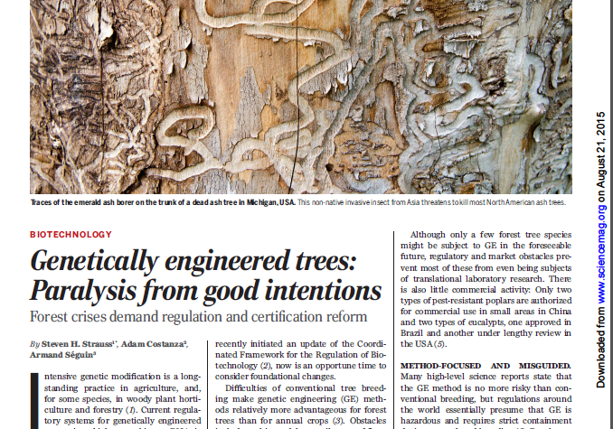
Market certification systems for forestry also a serious constraint

Slide 23
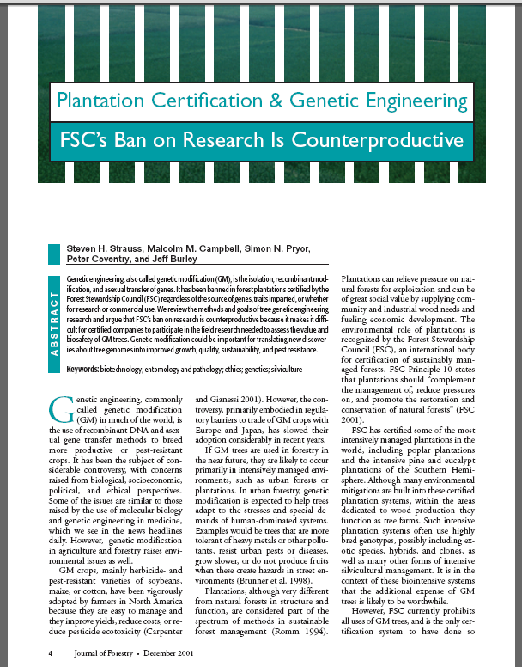

“Green” certification of forests create severe barriers to field research, markets
Forest Stewardship Council
“…genetically modified trees are prohibited…”

Slide 24
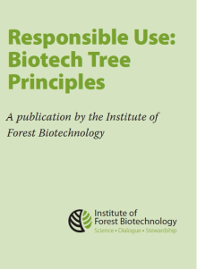
All forest certification systems now ban all GE trees – no exemptions
System | Region | GM Tree Approach / Reason
PEFC : Programme for Endorsement of Forest Certification | International | Banned / Precautionary approach based on lack of data
FSC : Forest Stewardship Council | International | Banned / Precautionary approach based on lack of data
CerFlor : Certificação Florestal | Brazil | Banned via PEFC registration / No additional rationale
CertFor : Certficación Forestal | Chile | Banned via PEFC registration / No additional rationale
SFI : Sustainable Forestry Initiative | North America | Banned via PEFC registration / Awaiting risk-benefit data
ATFS : American Tree Farm System | USA | Banned via PEFC registration / No additional rationale
CSA : Canadian Standards Association | Canada | Banned via PEFC registration / Allows public to determine approach
CFCC : China Forest Certification Council | China | Banned via PEFC registration / No additional rationale
Adam Costanza, Institute for Forest Biotechnology
Notes:
Outright bans are not stewardship plans
→ Responsible Use Principles

Slide 25
Forest health threats the reason we wrote the essay

Slide 26
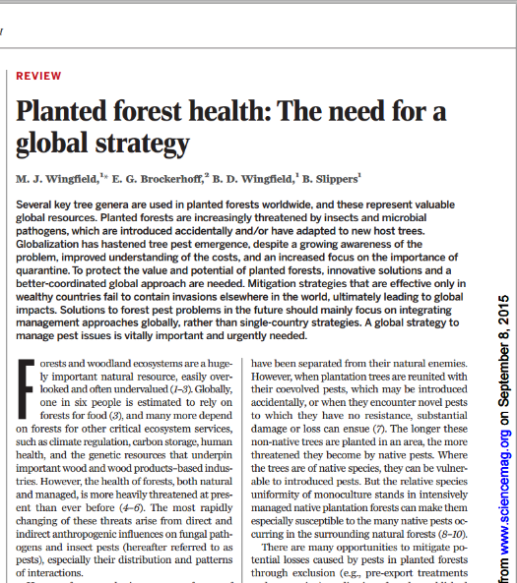


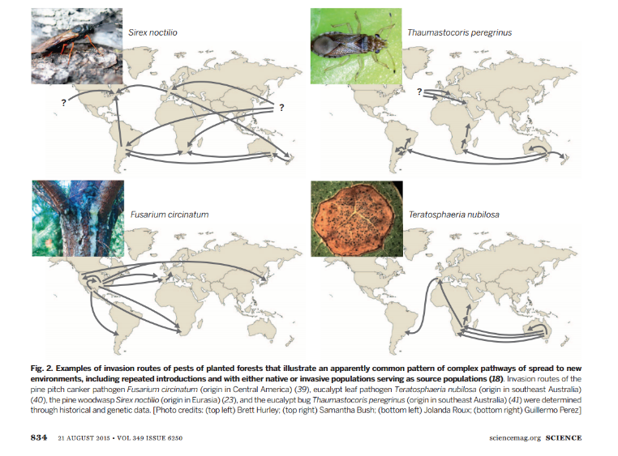
Forest health a major and growing concern

Slide 27
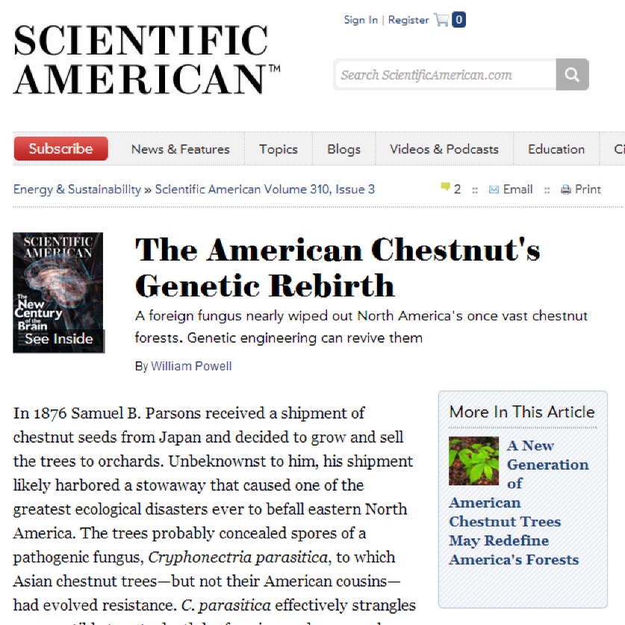
American Chestnut restoration – genomics and genetic engineering
March 2014 issue - Scientific American

Slide 28
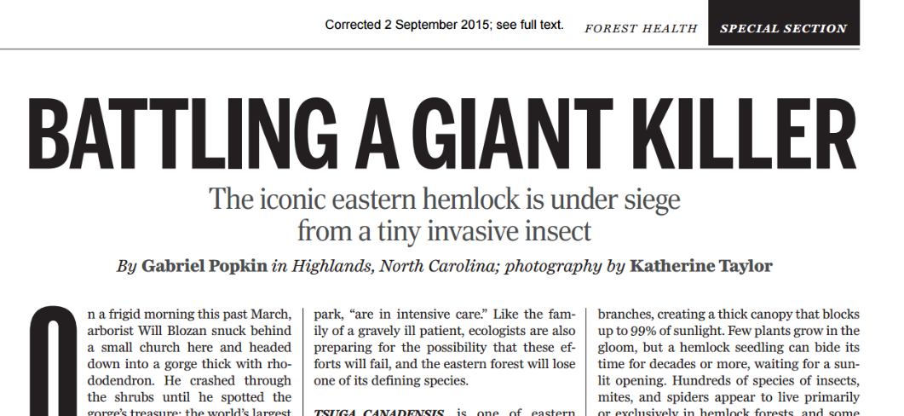
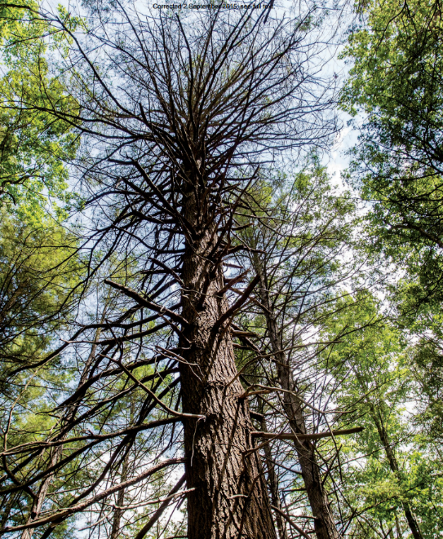
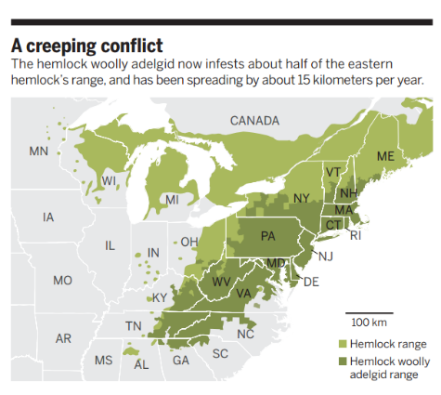
Hemlock in USA under siege today

Slide 29
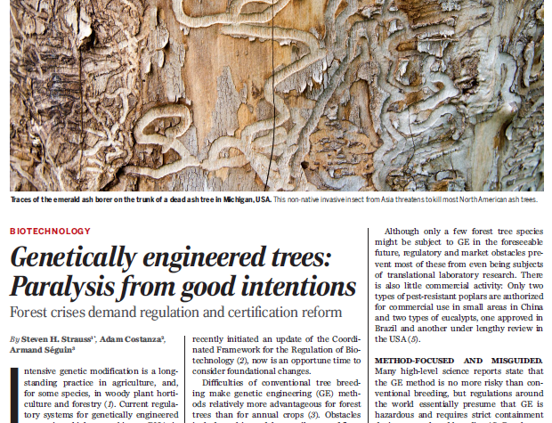
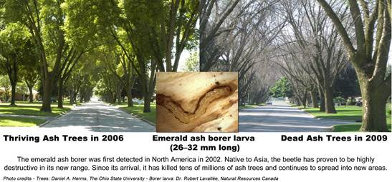
Emerald Ash Borer killing ~all ashes in USA – costing billions

Slide 30
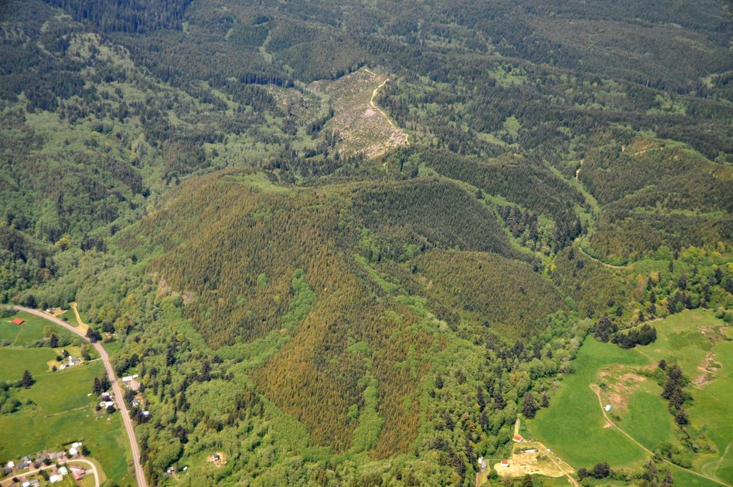
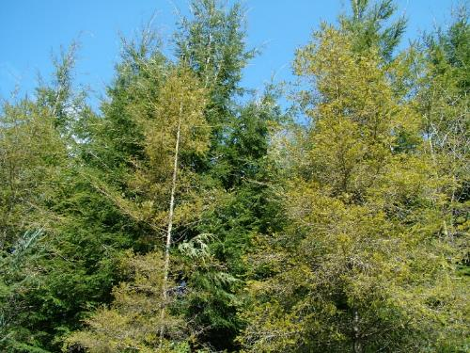
Swiss Needle Cast in Oregon Douglas-fir – breeding ineffective

Slide 31
Examples of GE trees

Slide 32
Technology diverse and effective
A great diversity of traits, and economic and/or environmental values, have been demonstrated in field trials of trees
Stability & efficacy is great—unstable, mutant types rare—but few species, mostly poplar, studied
- Herbicide tolerance
- Biotic, abiotic stresses
- Wood or fruit quality
- Form/stature and growth rate
- Containment
- Accelerated flowering
- Bioremediation
- Novel bioproducts

Slide 33
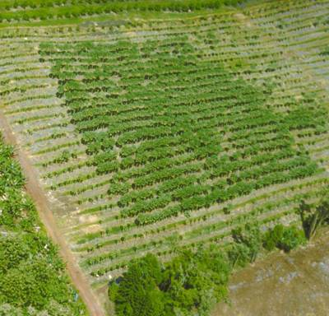
RNAi: Virus-resistant papaya
“Immunization” via by implanting a viral gene in the papaya genome – RNAi (RNA interference)
Courtesy of Denis Gonsalves, formerly of Cornell University
GMO, virus-resistant trees

Slide 34
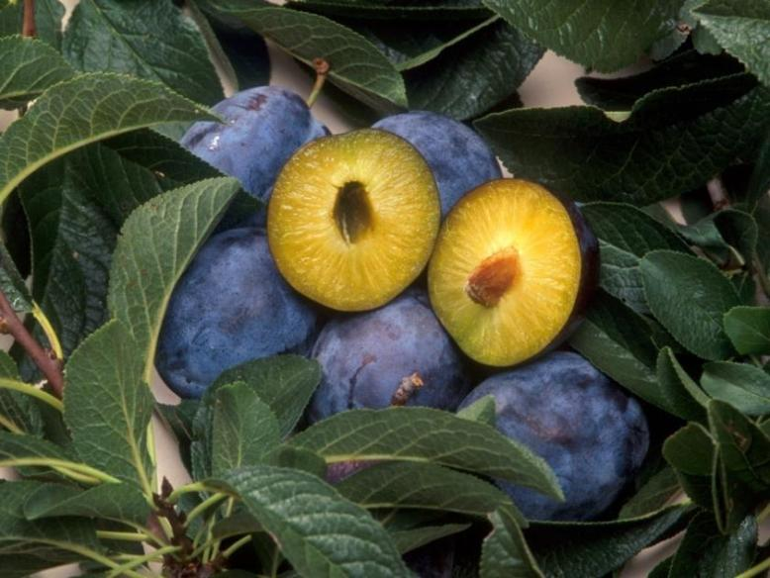
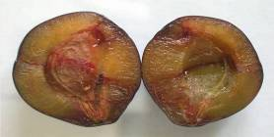
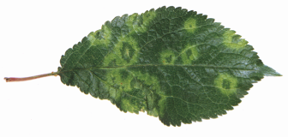
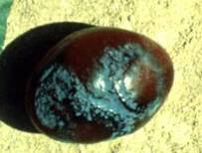
HoneySweet plum with RNAi
resistance to plum pox virus
Ralph Scorza USDA-ARS
GE
Non-GE

Slide 35
Non-browning “Arctic Apple”
RNAi suppression of native polyphenol oxidase gene expression
Courtesy of Jennifer Armen, Okanagan Specialty Fruits, Canada

Slide 36
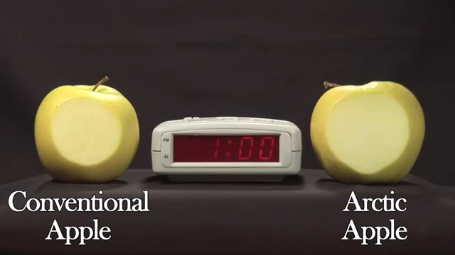
Non-browning “Arctic Apple”
Time lapse video

Slide 37
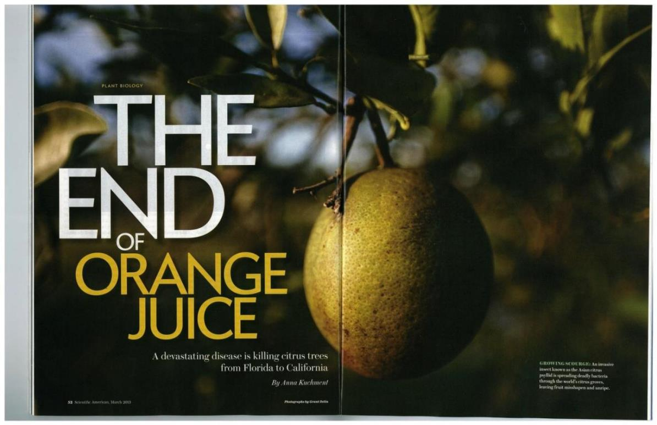
GE-based resistance transgenes promising in citrus
Scientific American
March, 2013

Slide 38
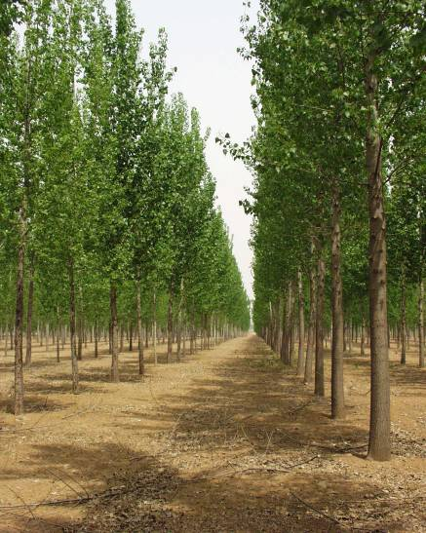
Lepidopteran-resistant poplars commercially approved in China - Bt cry1
Trait stable
Helps to protect non-Bt trees
Reduced insecticide use
Improved growth rate

Slide 39
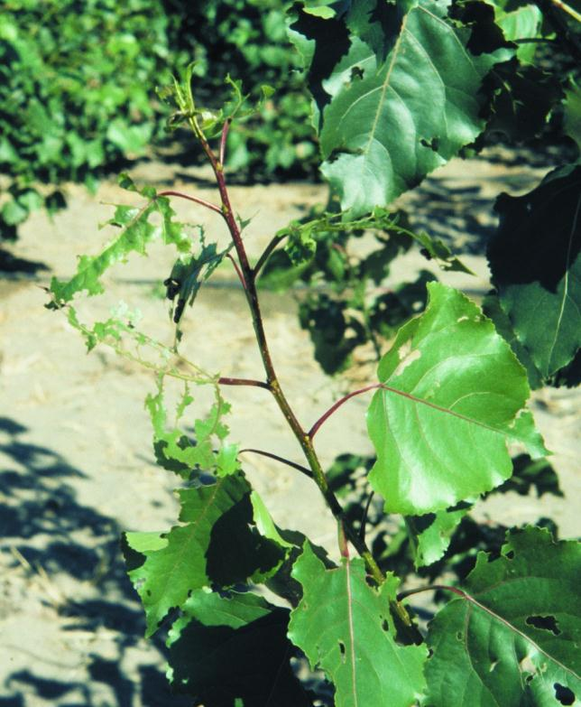
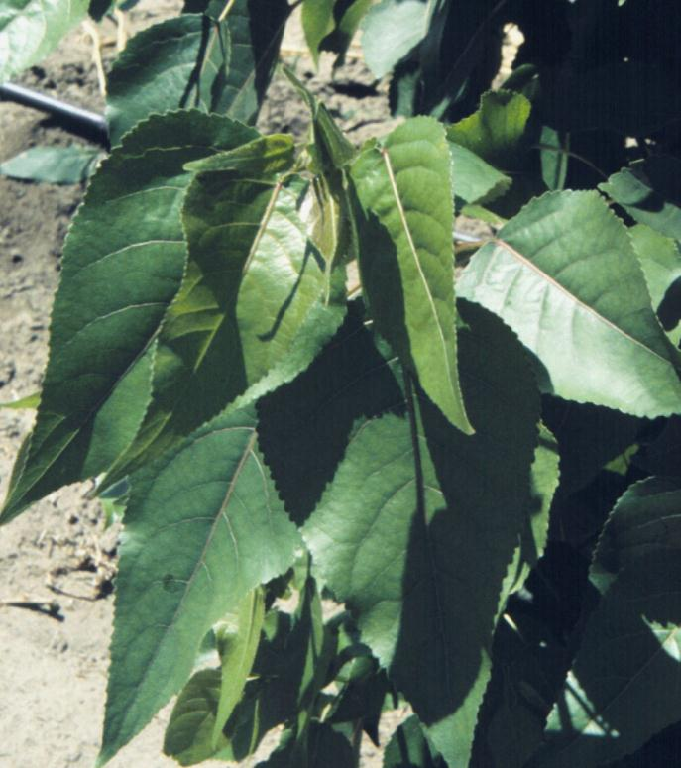
Coleopteran resistant Bt-cottonwoods in eastern Oregon field trial
Control
GE

Slide 40
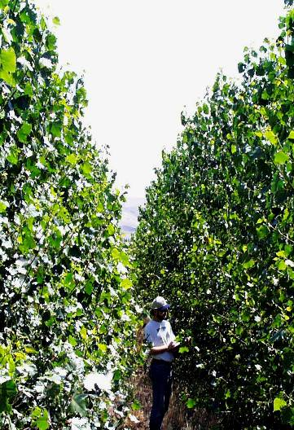
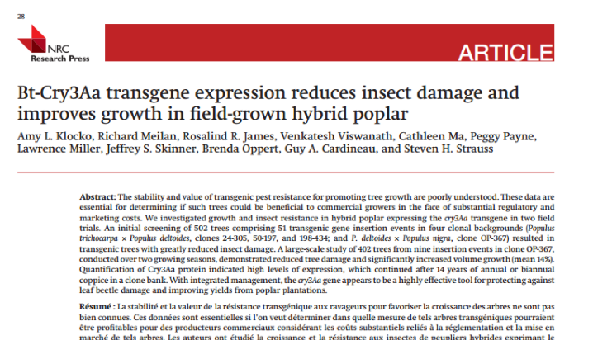
Growth benefits (10-20%) despite low insect pressure during large field trial of resistant genotypes
Wild type
GM

Slide 41
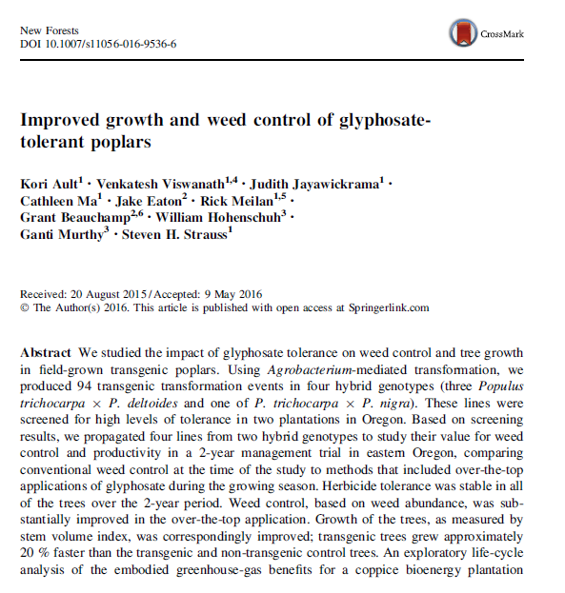
High value of herbicide resistance technology

Slide 42
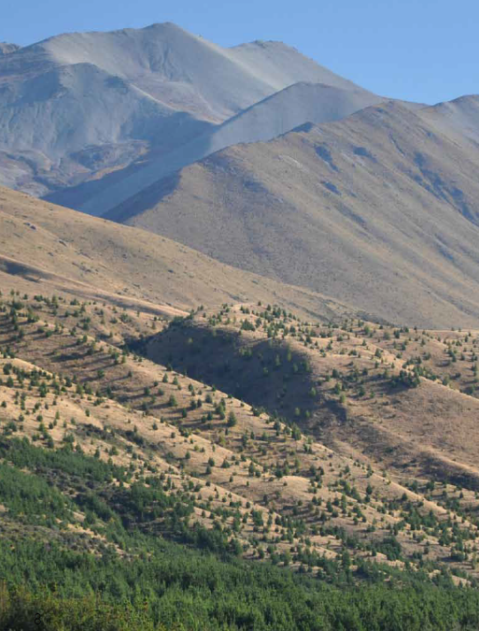
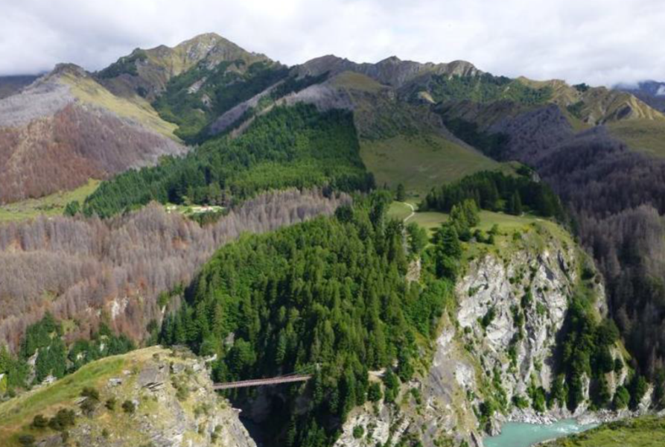
Sterility a valuable tool for transgene containment and containing exotics:
“Wilding” in New Zealand, South Africa, and others

Slide 43
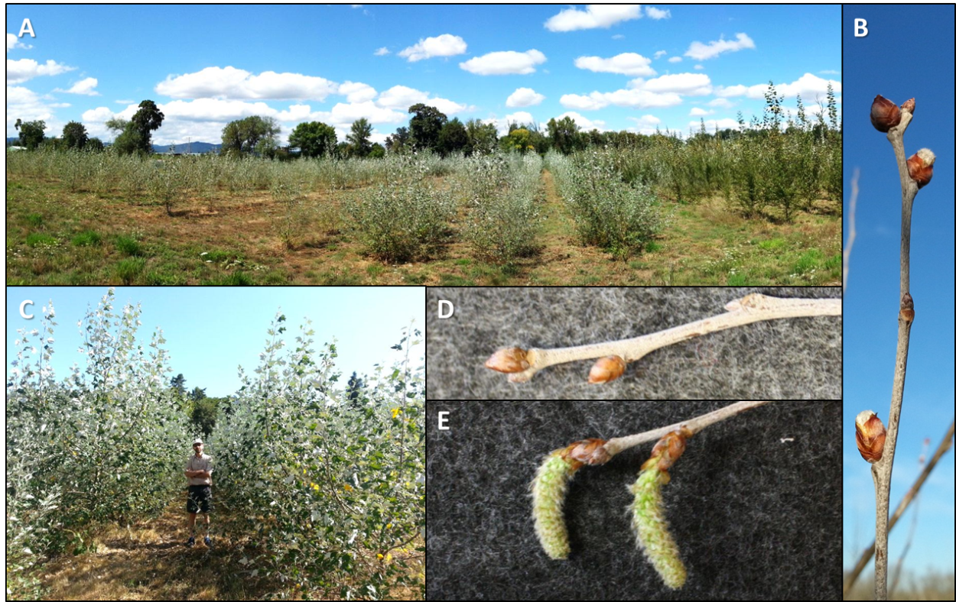
RNAi for complete sterility
RNAi field trial of poplar in Oregon: 25 constructs, 3 genotypes, 4,000 trees, 9 acres

Slide 44
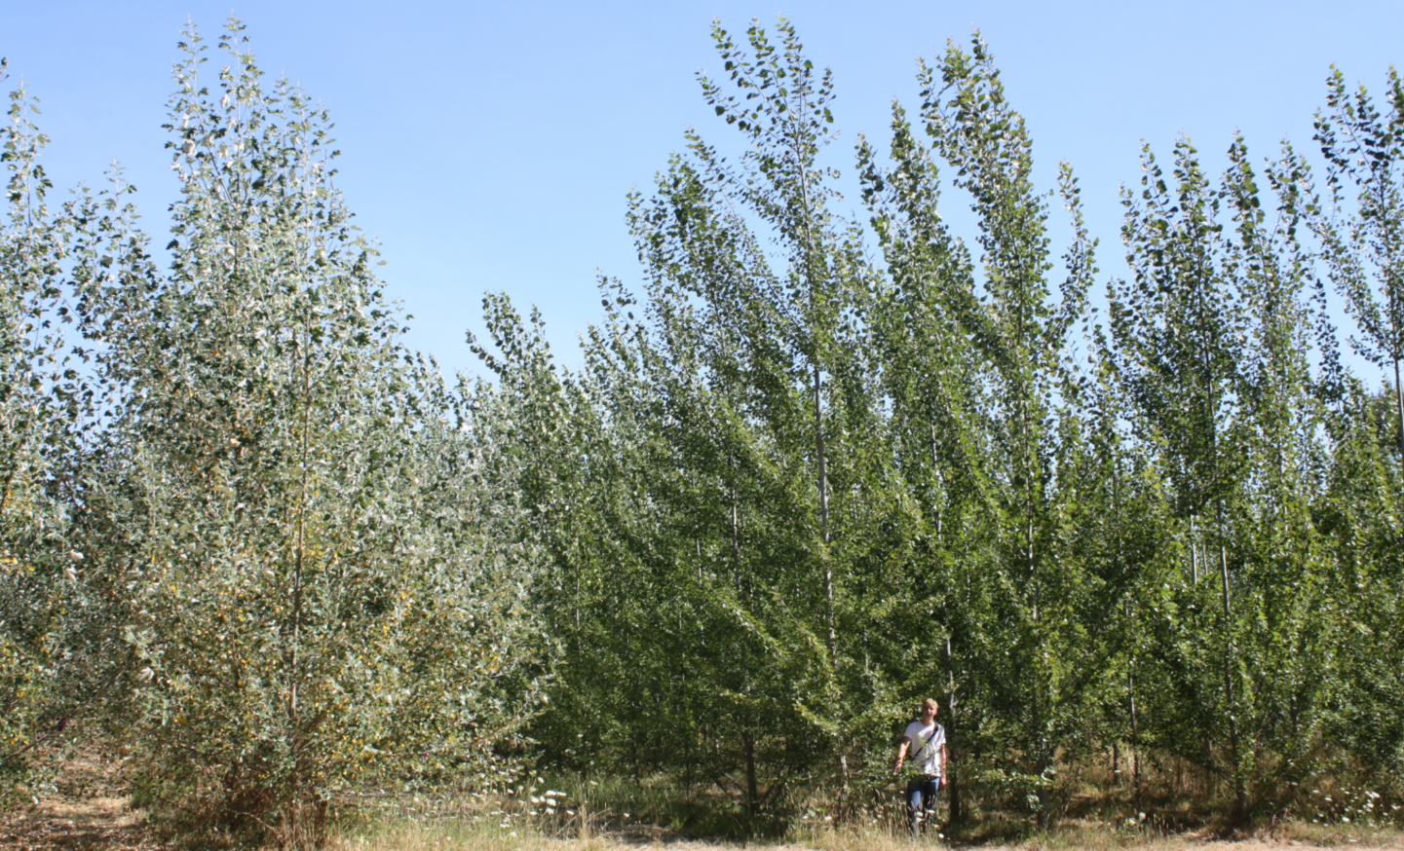
It takes a few years to flower
August 2015

Slide 45




Effective sterility
Undeveloped catkins, normal growth, with RNAi suppression of native LEAFY gene in poplar
control
Control
LFY
LFY
3-12-14
In press, Nature Biotechnology

Slide 46


CRISPRs
Predictable, stable sterility, ~10% biallelic mutation rate
Wild type`
Insertion
Mutants
AG-2
target site
AG-1
target site
Small deletions
Large deletion

Slide 47
In summary
Considerable need, many examples of progress in the field
  Forest health needs growing
  Progress despite social barriers and disinvestment
Large barriers based on biology and society
  Economics, conventional breeding, transformation capability, intellectual property, regulatory
  Makes implementation of GE tools on a scale and speed relevant to need unworkable
Need for fundamental regulatory and
market change
  Decriminalization of GE method, tiers, exemptions

